Slide 1
Data Governance
David Haffner
Velly Duverny

Slide 2
Agenda
What is Data Governance
Data Governance Video
Data Governance in Business
Creating a Data Warehouse with Governance
Blue Cross Blue Shield of North Carolina (BCBSNC)
Data Governance Solutions
Data Governance Tools

Slide 3
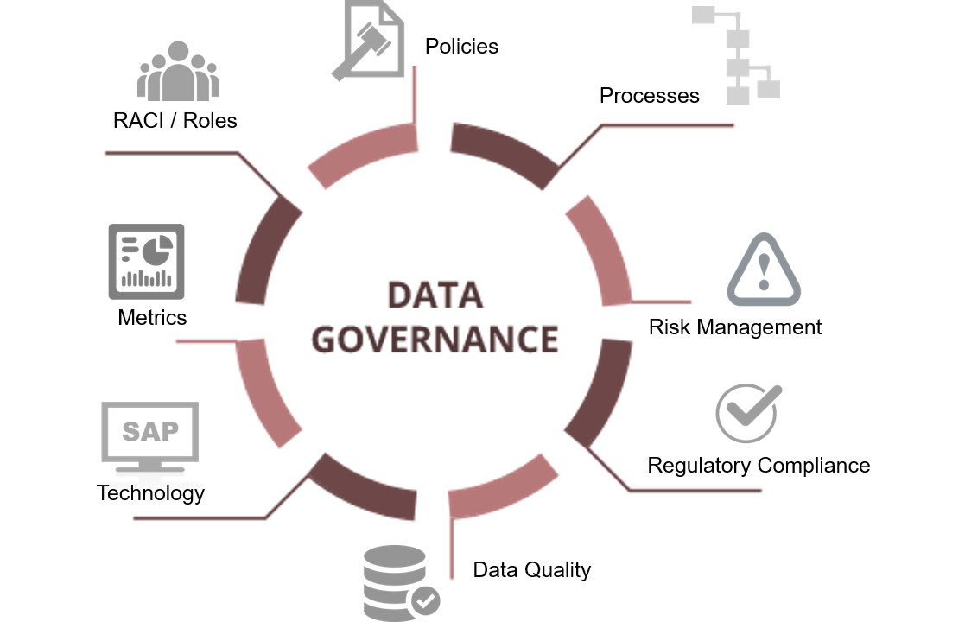
What is Data Governance?
Data Governance is a set of practices and concepts which prioritize and organize data, as well as the enforcement of policies around data, while following various regulations and curtailing poor data practices.
Still relatively new idea to business
Data Governance is here to stay

Slide 4
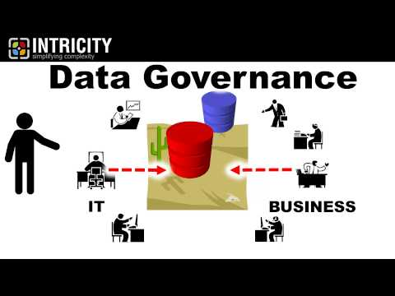
Understanding Data Governance

Slide 5
Data Governance in Business
Current data governance techniques are very labor-intensive
Teams of employees from different departments, typically rely on best practices to transform business policies to data governance regulations.
Current approaches do not scale to the complexity and variety of data as an increasing number of data requirements, use cases, applications, tools and systems come into play.
Quality over Quantity
Open Data allows for business innovation.
Quality Data may be hard to come by; lack of metadata

Slide 6
Data Governance in Business
Organizations have recently turned to consumer data to improve their business strategies.
Businesses are treating data as assets
Management-level people are using this data to reconstruct their business models
Artificial intelligence, AI, is being used to:
Improve discoverability (Data Assets)
Quality
Compliance
Data governance models differ based on the business.

Slide 7
Blue Cross Blue Shield of North Carolina
Blue Cross Blue Shield of North Carolina (BCBSNC) is the largest health insurer in North Carolina serving 2.8 million members
BCBSNC views being customer-focused as an important element for their data governance systems
Blue Cross Blue Shield of North Carolina (BCBSNC) was recognized by Transforming Data with Intelligence, TDWI, for best practices in data warehousing governance.
Ever-changing health care regulations causes BCBSNC to constantly change their data governance system. (HIPAA)

Slide 8
Processes of Data Governance
Must address many processes:
Identifying business needs: Reasons for developing warehouse a) Improve communication & information sharing between departments in a business b) The business departments must take charge of creating the data warehouse; not the IS/IT department
Align warehouse model with company goals. a) System must support business needs b) Maintenance is an ongoing process
Determine information requirements

Slide 9
Processes of Data Governance
4) Setting Priorities a) Prototype should have one or few subject areas b) As business continues to grow; subject areas and user may grow.
5) Establishing Data Definitions & models a) What data definitions to use? b) What model is most efficient and effect for running queries.
6) Maintaining Data Quality. a) As said earlier, Businesses want quality information over quantity. b) Data quality will always have to be monitored and require immediate attention when their appear

Slide 10
Data Governance Solutions
Amazon Web Services
IBM
Microsoft
Oracle
SAP
Teradata
Cloudera
Dell Boomi
SAS
TIBCO Software

Slide 11
Data Governance Tools
Tag inspector
Acaveo
Agility
Alfresco one
Alteryx designer
Asigra

Slide 12
References (Non-Refereed)
https://www.sas.com/en_us/insights/articles/data-management/what-is-a-data-governance-framework.html
https://www.edq.com/blog/best-practices-in-data-governance/ http://egovstandards.gov.in/sites/default/files/oea-best-practices-data-gov-400760.pdf
https://www.youtube.com/watch?v=sHPY8zIhy60
https://www.computerworld.com/article/3032333/enterprise-architecture/data-governance-so-mom-can-understand.html
https://taginspector.com/data-governance-tools/
https://www.datamation.com/big-data/top-10-data-governance-solutions.html
https://www.bluecrossnc.com/about-us/governance-and-leadership
https://blogs.oracle.com/financialservices/five-key-questions-for-your-bcbs-239-data-governance-strategy
https://www.manufacturing.net/article/2017/09/10-steps-creating-successful-data-governance-strategy
https://dbhids.org/wp-content/uploads/2017/09/OCIO_DBHIDS-Data-Governance-Framework-Implementation-Plan-v1.pdf

Slide 13
References (Refereed)
https://www.sciencedirect.com/science/article/pii/S0268401216309021
https://dl.acm.org/citation.cfm?id=3211955
https://www.sciencedirect.com/science/article/pii/S0167923603001209
https://aisel.aisnet.org/cgi/viewcontent.cgi?article=1110&context=acis2007
https://dl.acm.org/citation.cfm?id=1629210
https://dl.acm.org/citation.cfm?id=1806449
https://aisel.aisnet.org/cgi/viewcontent.cgi?referer=https://scholar.google.com/&httpsredir=1&article=1271&amp;context=ecis2011
https://www.alexandria.unisg.ch/213308/
https://search.proquest.com/openview/7f4089649cbe9d03ff7a8d2e9206caf9/1?pq-origsite=gscholar&cbl=51938
https://www.alexandria.unisg.ch/214034/
https://ieeexplore.ieee.org/abstract/document/7545932

